Slide 1
CS639: Data Management for Data Science
Lecture 16: Intro to ML and Decision Trees
Theodoros Rekatsinas
(lecture by Ankur Goswami many slides from David Sontag)

Slide 2
Today’s Lecture
Intro to Machine Learning
Types of Machine Learning
Decision Trees

Slide 3
Intro to Machine Learning

Slide 4
What is Machine Learning?
“Learning is any process by which a system improves performance from experience” – Herbert Simon
Definition by Tom Mitchell (1998):
Machine Learning is the study of algorithms that
Improve their performance P
at some task T
with experience E
A well-defined learning task is given by <P, T, E>.

Slide 5
What is Machine Learning?
Machine Learning is the study of algorithms that
Improve their performance P
at some task T
with experience E
A well-defined learning task is given by <P, T, E>.
Experience: data-driven task, thus statistics, probability
Example: use height and weight to predict gender

Slide 6
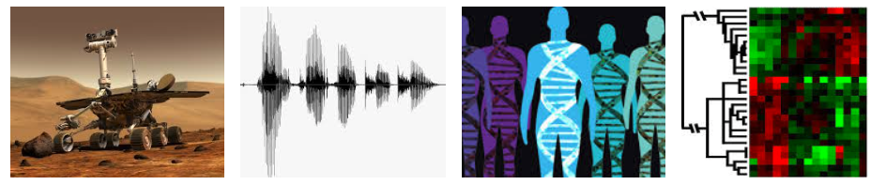
When do we use machine learning?
ML is used when:
Human expertise does not exist (navigating on Mars)
Humans can’t explain their expertise (speech recognition)
Models must be customized (personalized medicine)
Models are based on huge amounts of data (genomics)

Slide 7
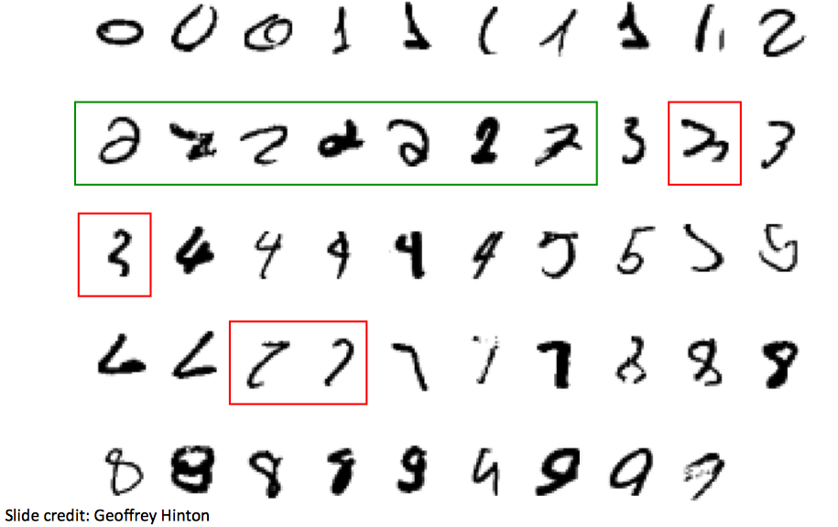
A task that requires machine learning
What makes a hand drawing be 2?

Slide 8
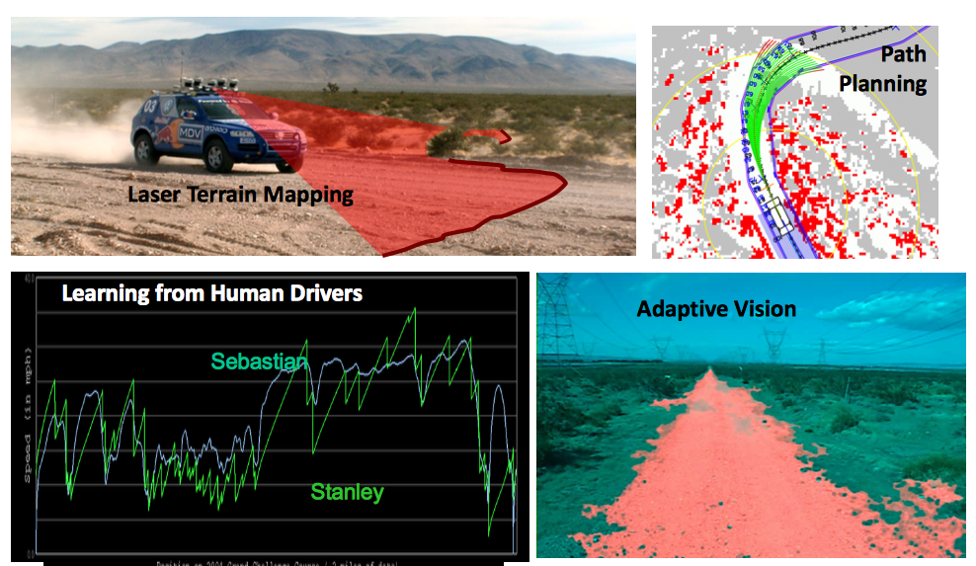
Modern machine learning: Autonomous cars

Slide 9
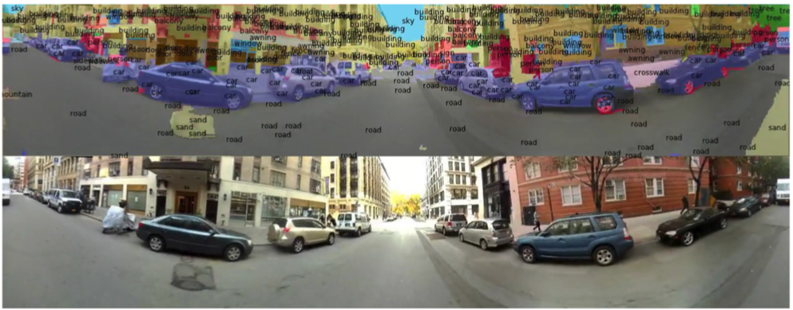
Modern machine learning: Scene Labeling

Slide 10
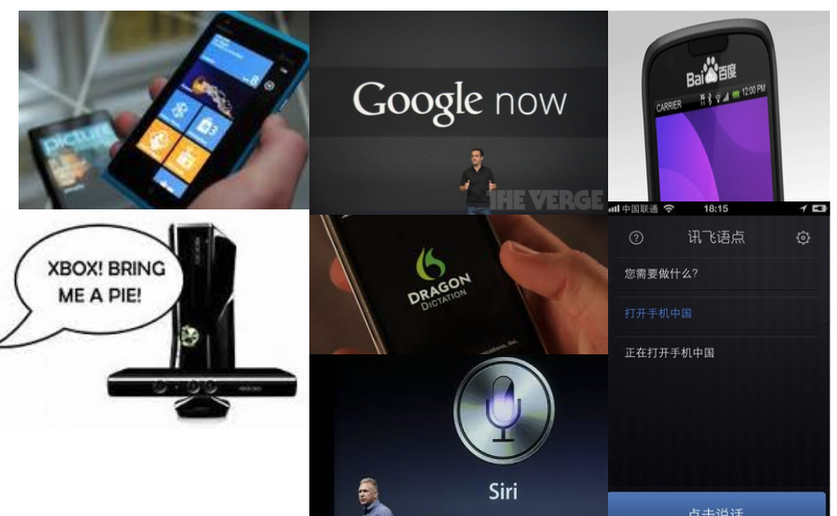
Modern machine learning: Speech Recognition

Slide 11
2. Types of Machine Learning

Slide 12
Types of Learning
Supervised (inductive) learning
Given: training data + desired outputs (labels)
Unsupervised learning
Given: training data (without desired outputs)
Semi-supervised learning
Given: training data + a few desired outputs
Reinforcement learning
Rewards from sequence of actions

Slide 13
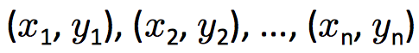
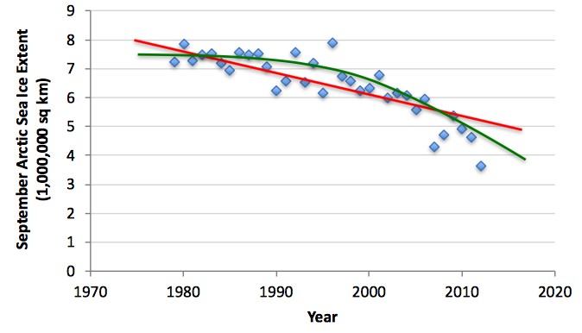
Supervised Learning: Regression
Given
Learn a function f(x) to predict y given x
y is real-valued == regression

Slide 14
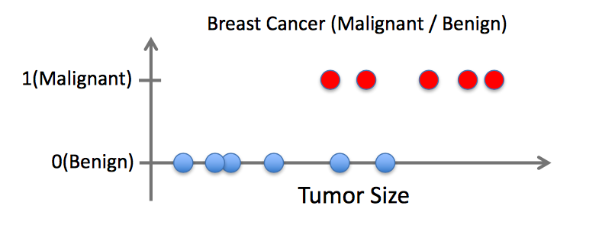
Supervised Learning: Classification
Given
Learn a function f(x) to predict y given x
y is categorical == regression

Slide 15
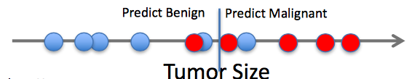
Supervised Learning: Classification
Given
Learn a function f(x) to predict y given x
y is categorical == regression

Slide 16
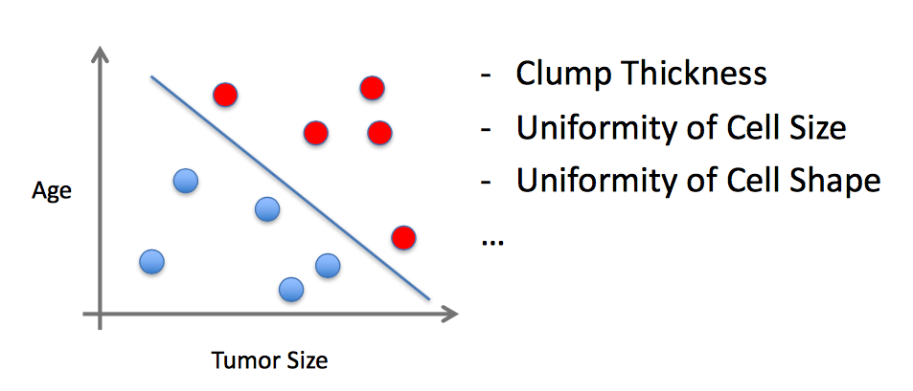
Supervised Learning
Value x can be multi-dimensional.
Each dimension corresponds to an attribute

Slide 17
Types of Learning
Supervised (inductive) learning
Given: training data + desired outputs (labels)
Unsupervised learning
Given: training data (without desired outputs)
Semi-supervised learning
Given: training data + a few desired outputs
Reinforcement learning
Rewards from sequence of actions
We will cover later in the class

Slide 18
3. Decision Trees

Slide 19
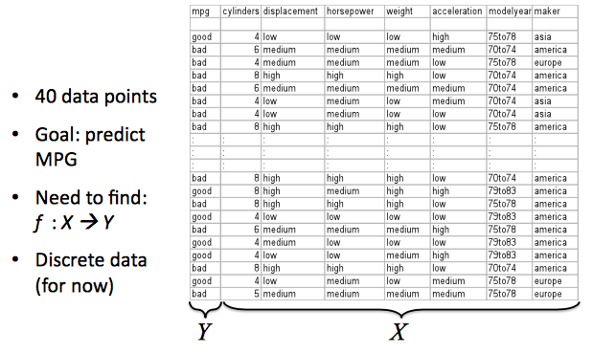
A learning problem: predict fuel efficiency

Slide 20
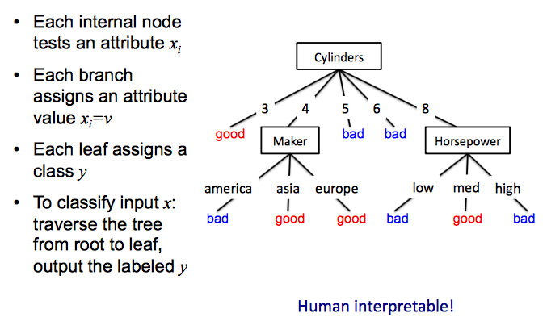
Hypotheses: decision trees f: X → Y
Informal
A hypothesis is a certain function that we believe (or hope) is similar to the true function, the target function that we want to model.

Slide 21
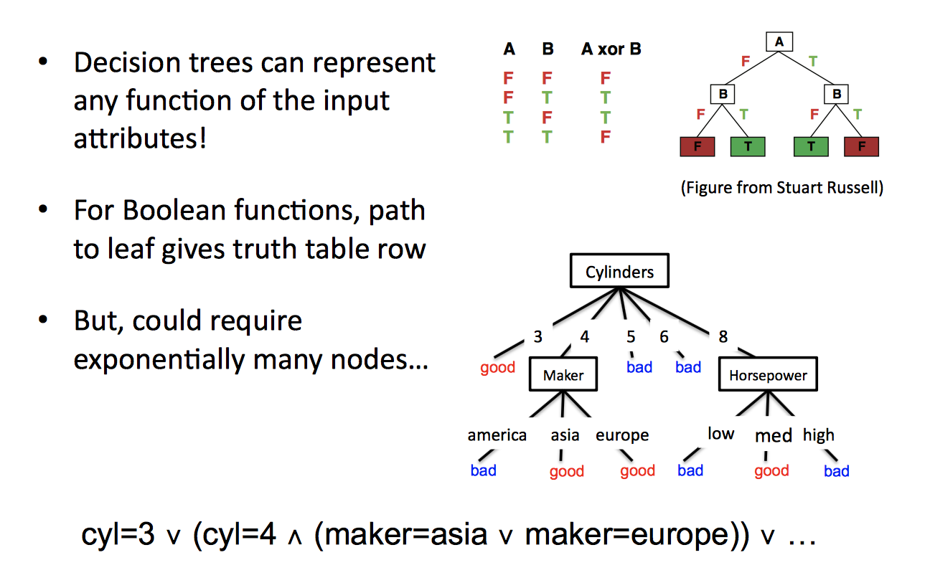
What functions can Decision Trees represent?

Slide 22
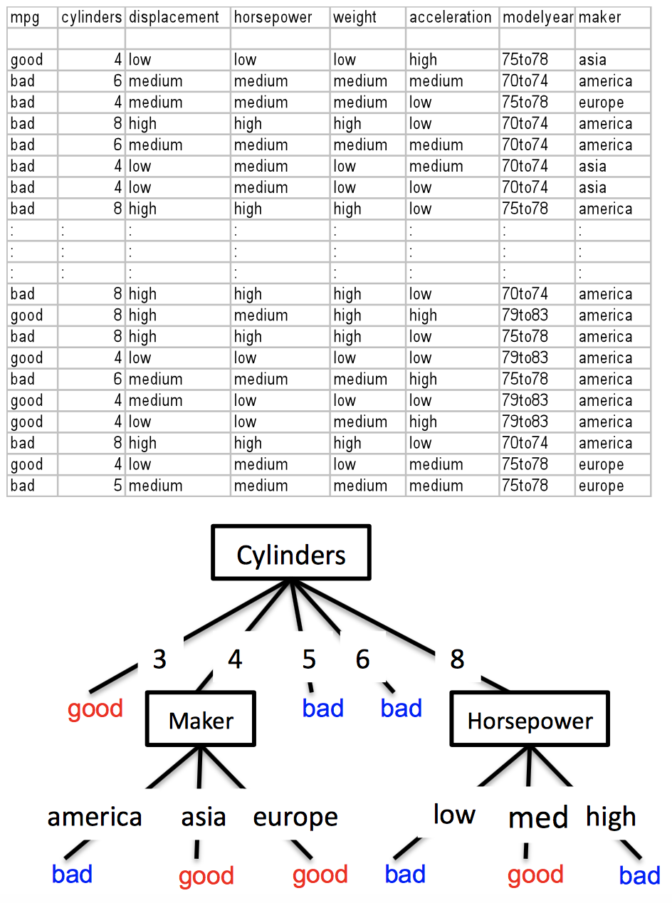
Space of possible decision trees
How will we choose the best one?
Lets first look at how to split nodes, then consider how to find the best tree

Slide 23
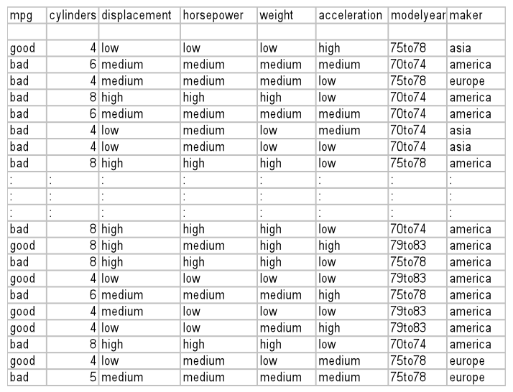
What is the simplest tree?
Always predict mpg = bad
We just take the majority class
Is this a good tree?
We need to evaluate its performance
Performance: We are correct on 22 examples and incorrect on 18 examples

Slide 24
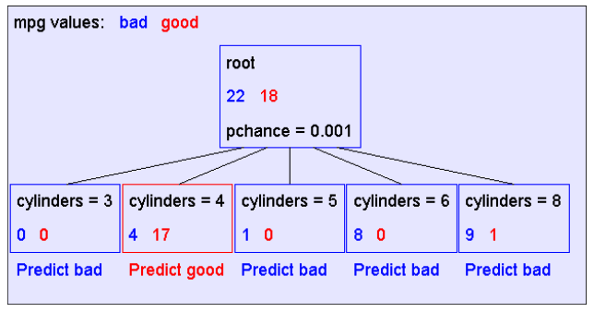
A decision stump

Slide 25
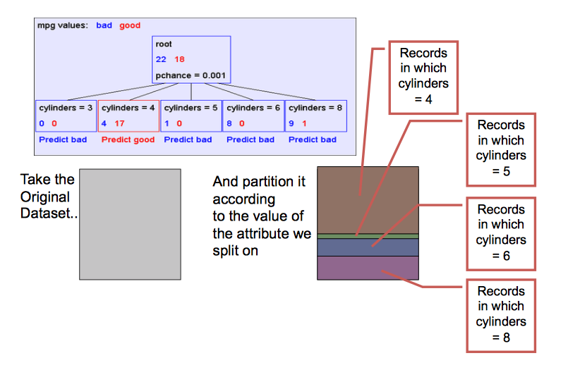
Recursive step

Slide 26
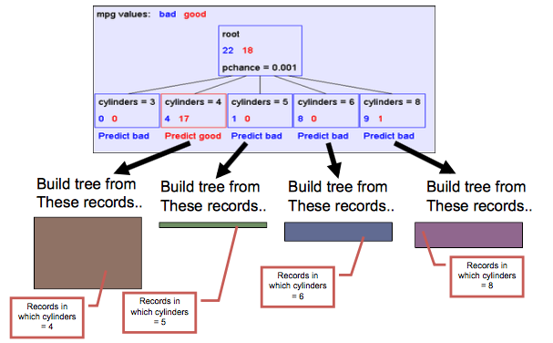
Recursive step

Slide 27
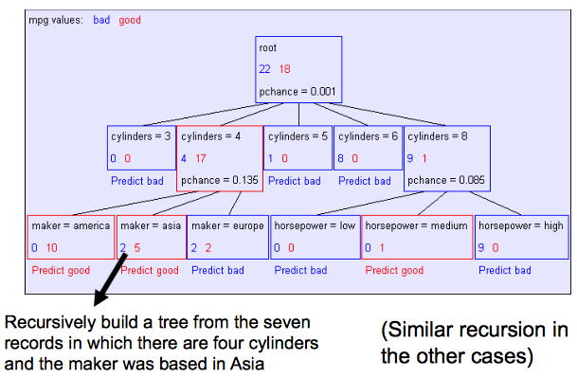
Second level of tree

Slide 28
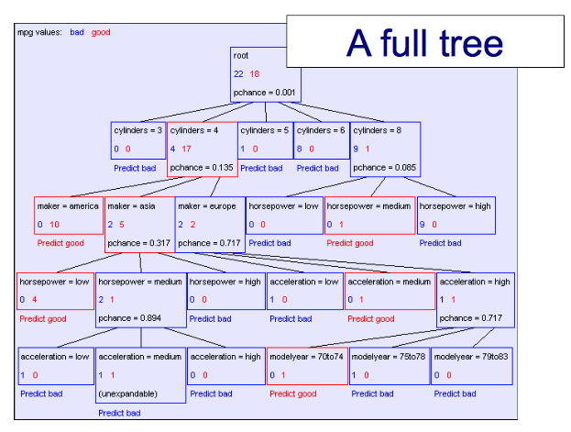

Slide 29
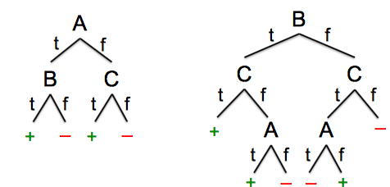
Are all decision trees equal?
Many trees can represent the same concept
But, not all trees will have the same size!
e.g., φ = ( A ∧ B)∨(¬A ∧ C) -- ((A and B) or ( not A and C))
Which tree do we prefer?

Slide 30
Learning decision trees is hard
Learning the simplest (smallest) decision tree is an NP-complete problem [Hyafil & Rivest ’76]
Resort to a greedy heuristic:
Start from empty decision tree
Split on next best attribute (feature)
Recurse

Slide 31
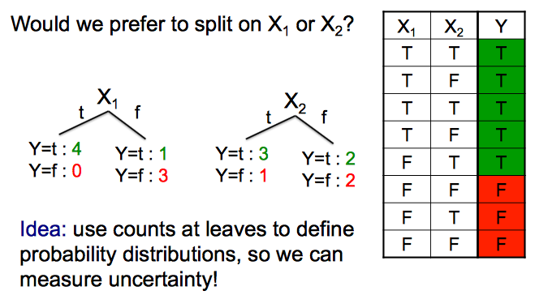
Splitting: choosing a good attribute

Slide 32
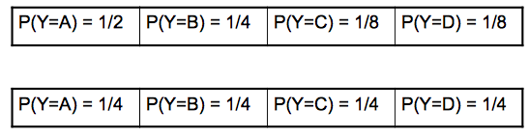
Measuring uncertainty
Good split if we are more certain about classification after split
Deterministic good (all true or all false)
Uniform distribution bad
What about distributions in between?

Slide 33
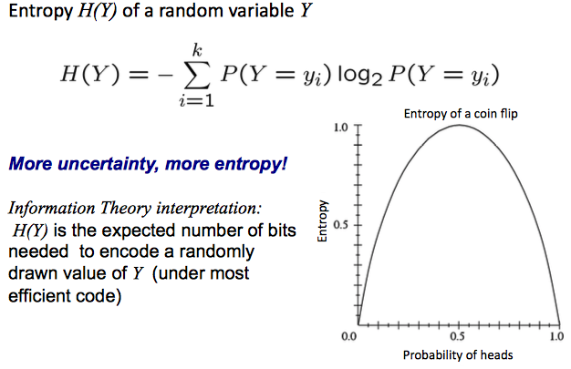
Entropy

Slide 34
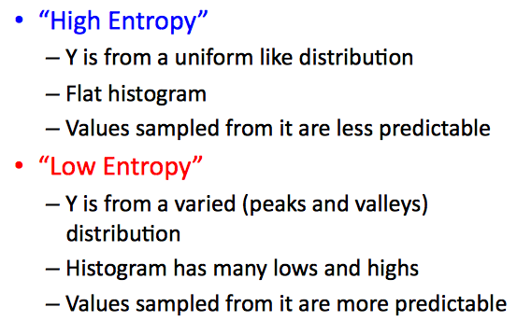
High, Low Entropy

Slide 35
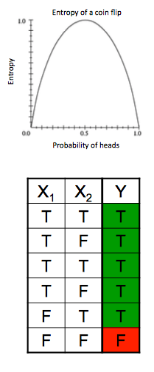
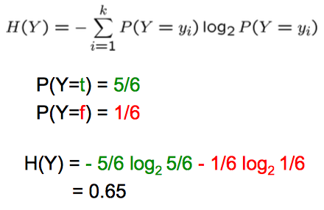
Entropy Example

Slide 36
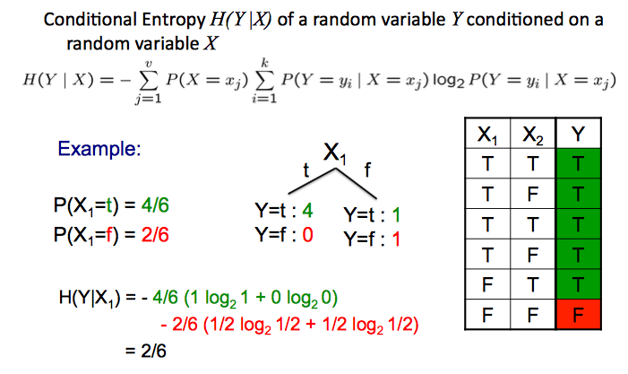
Conditional Entropy

Slide 37
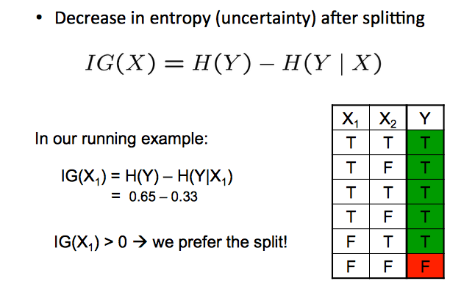
Information gain

Slide 38
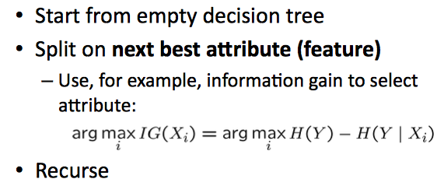
Learning decision trees

Slide 39
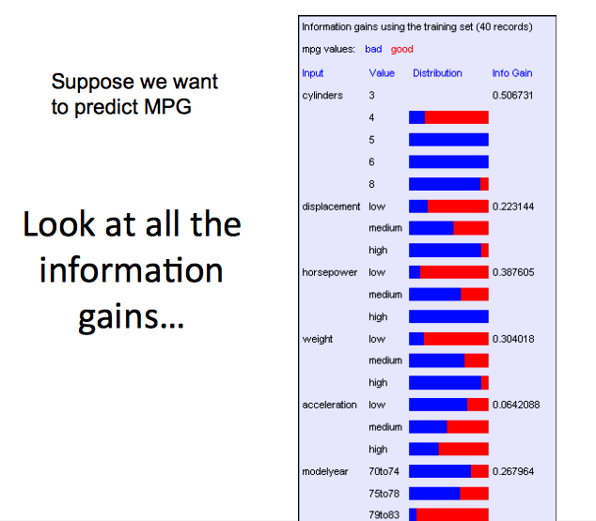

Slide 40
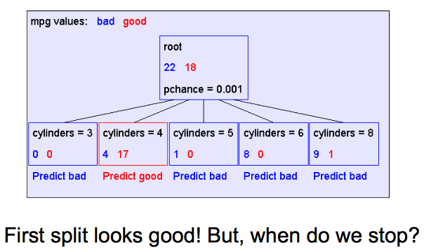
A decision stump

Slide 41
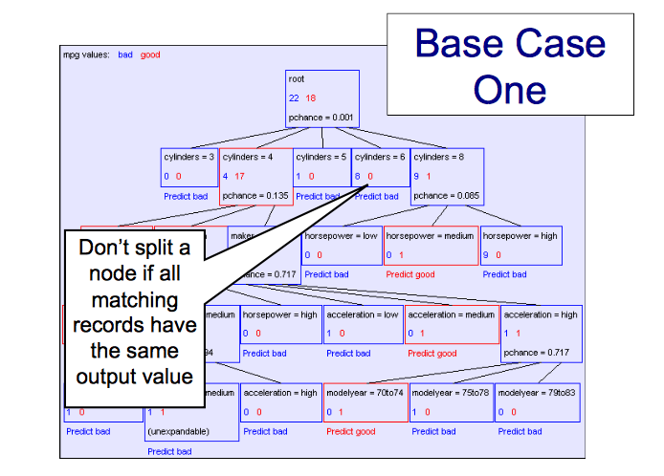

Slide 42
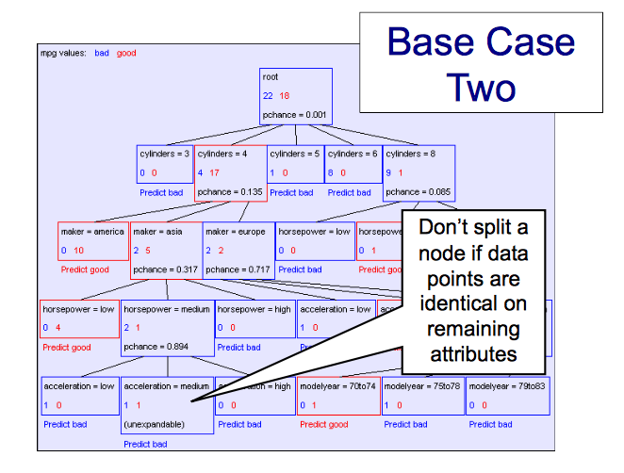

Slide 43
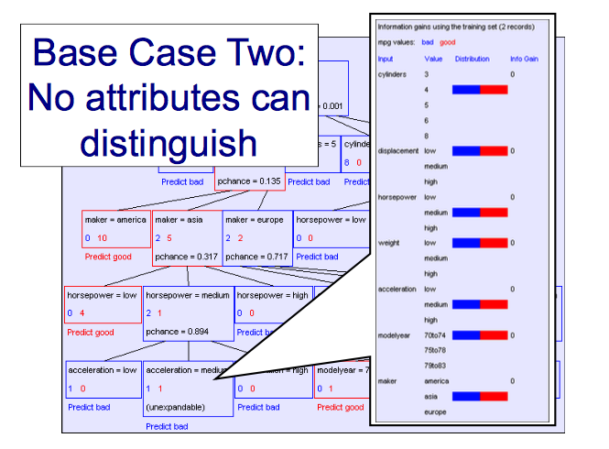

Slide 44
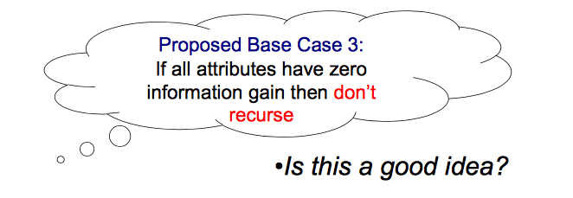
Base Cases: An Idea
Base Case One: If all records in current data subset have the same output then do not recurse
Base Case Two: If all records have exactly the same set of input attributes then do not recurse

Slide 45
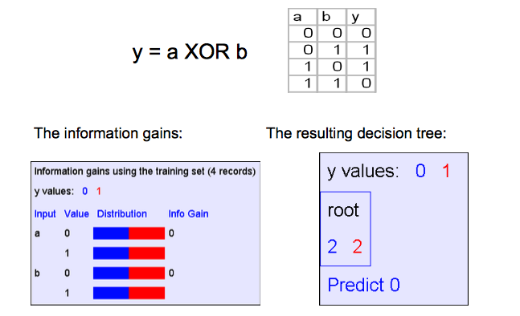
The problem with Base Case 3

Slide 46
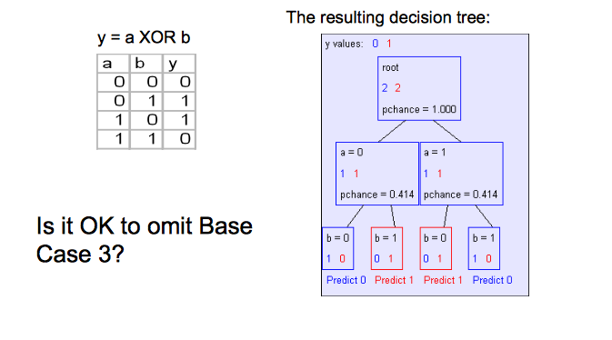
If we omit Base Case 3

Slide 47
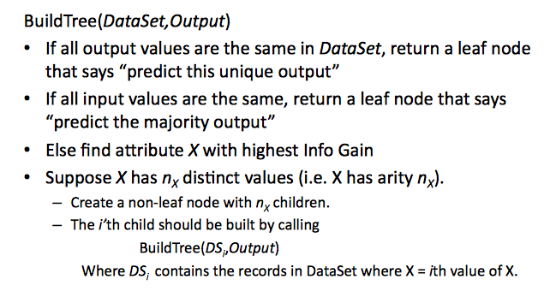
Summary: Building Decision Trees

Slide 48
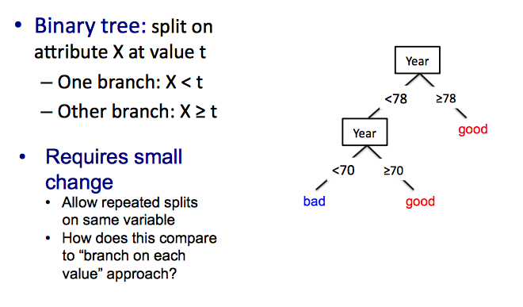
From categorical to real-valued attributes

Slide 49
What you need to know about decision trees
Decision trees are one of the most popular ML tools
Easy to understand, implement, and use
Computationally cheap (to solve heuristically)
Information gain to select attributes
Presented for classification but can be used for regression and density estimation too
Decision trees will overfit!!!
We will see the definition of overfitting and related concepts later in class.

